Slide 1

Strategic Investment Opportunity
Investment Committee Presentation | Confidential

Slide 2
EXECUTIVE SUMMARY
Investment Opportunity at a Glance
Investment Highlights
$2.5B
18%
We have identified a compelling investment opportunity in a high-growth business with strong fundamentals, defensible competitive advantages, and exceptional management team capabilities. The target company operates in an attractive market segment experiencing accelerating demand tailwinds and limited competition.
Enterprise Value
Revenue CAGR
Attractive entry valuation at 8.5x EBITDA
Three-year projected growth trajectory
32%
2.5x
This opportunity represents an ideal fit with our investment strategy, offering both significant value creation potential and downside protection through multiple structural advantages.
EBITDA Margin
Target MOIC
Best-in-class profitability metrics
Five-year expected return multiple

Slide 3

Key Investment Rationale
Market Leadership Position
Proven Business Model
The target has demonstrated consistent revenue growth of 15-20% annually over the past five years, with expanding margins driven by operational leverage and strategic pricing initiatives. The business model is capital-efficient with strong cash conversion.
The company holds a commanding 28% market share in its core segment, with the next competitor at only 12%. This leadership position provides pricing power, customer loyalty, and economies of scale that create a formidable competitive moat.
Multiple Value Levers
We have identified five distinct value creation opportunities including market expansion, operational improvements, strategic M&A, technology integration, and margin enhancement initiatives that collectively support our return thesis.

Slide 4

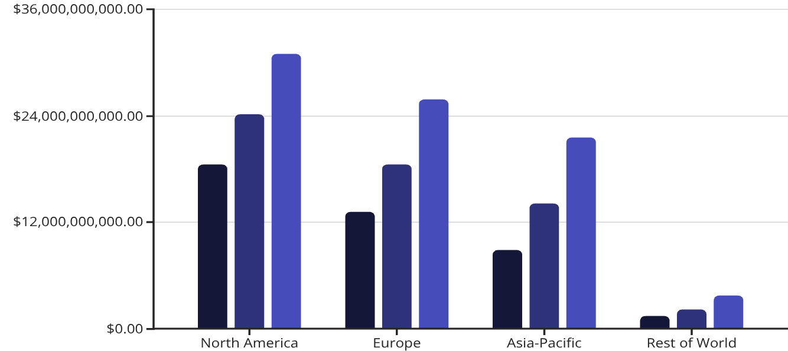
MARKET OPPORTUNITY
Large and Growing Addressable Market
The target company operates in a $42 billion global market that is projected to grow at a 12% compound annual growth rate through 2030. This growth is driven by several powerful secular trends including digital transformation, regulatory tailwinds, and changing consumer preferences.
Market Dynamics: The industry is experiencing consolidation, with larger players gaining share from fragmented regional competitors. This creates significant opportunities for bolt-on acquisitions and organic market share gains.
2024E
2027E
2030E
Geographic Expansion: While the company currently generates 75% of revenue in North America, international markets represent a substantial untapped opportunity. Key markets in Europe and Asia-Pacific are growing faster than domestic markets and remain underpenetrated.
Product Innovation: Emerging product categories within the addressable market are growing at 20%+ annually, and the company has established early leadership positions in three of the four fastest-growing segments.

Slide 5

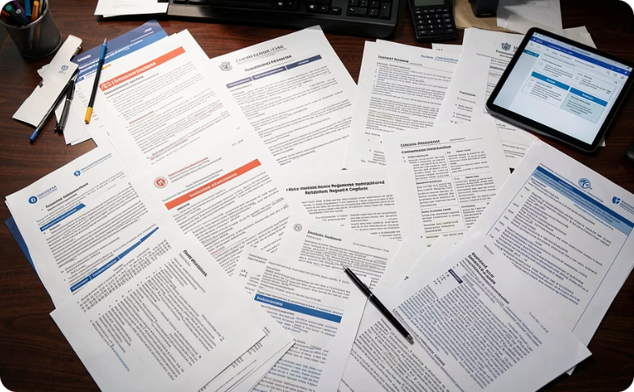

Market Growth Drivers
Digital Transformation
Regulatory Mandates
Consumer Behavior Shifts
Enterprises are accelerating technology adoption and digital infrastructure investments, creating sustained demand for the company's solutions. This trend has intensified post-pandemic and shows no signs of abating.
New regulations across multiple jurisdictions require enhanced compliance capabilities, directly benefiting the target's core offerings. Regulatory complexity is increasing, driving demand for specialized solutions.
Fundamental changes in how end-users interact with technology and services create new market opportunities. The company is well-positioned to capitalize on these evolving preferences and expectations.

Slide 6
COMPETITIVE POSITION
Defensible Competitive Moat
The target company has built multiple layers of competitive protection that create significant barriers to entry and defend against existing competitors. These advantages are structural, sustainable, and difficult to replicate.
1
Network Effects
2
Proprietary Technology
The platform becomes more valuable as more users and partners join the ecosystem. With over 15,000 active enterprise customers and 200+ integration partners, the network creates powerful switching costs and competitive barriers. New competitors would need to replicate not just the technology, but the entire ecosystem—a virtually impossible task.
The company owns 47 patents covering core functionality and has 23 additional applications pending. The technology stack represents over $120 million in R&D investment and incorporates machine learning capabilities that improve with scale. This intellectual property portfolio provides both defensive protection and offensive licensing opportunities.
3
Customer Stickiness
4
Brand Recognition
Net revenue retention of 118% demonstrates deep customer integration and expansion. Average customer tenure exceeds seven years, with enterprise clients deeply embedding the platform into mission-critical workflows. Implementation typically requires 4-6 months and significant change management, creating substantial switching costs.
The company ranks #1 in unaided brand awareness among target buyers and maintains Net Promoter Scores above 70. Brand strength translates directly to sales efficiency, with customer acquisition costs 40% lower than the peer group average. This brand equity has been built over 15+ years and represents an intangible asset that competitors cannot easily replicate.

Slide 7
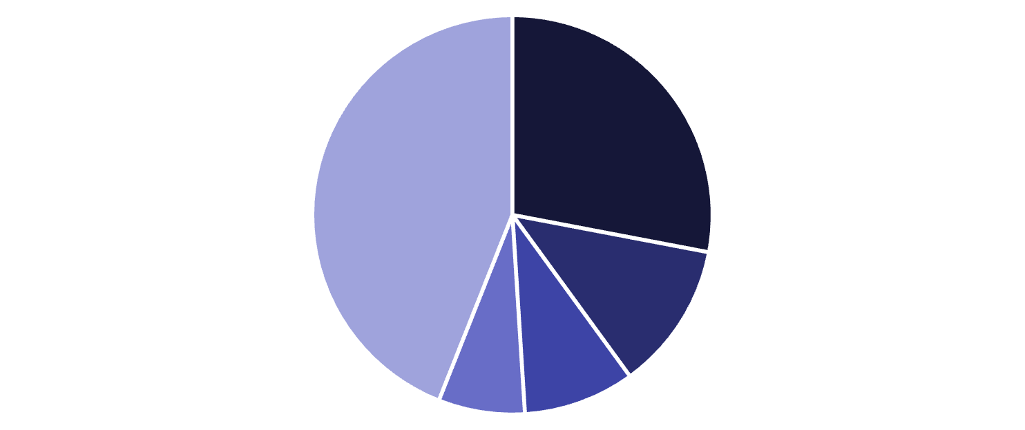
Competitive Landscape Analysis
Market Position Overview
The competitive landscape is characterized by a clear leader (the target company), two credible but smaller competitors, and a fragmented tail of regional and specialized players. The target's scale advantages are accelerating, with the gap between #1 and #2 widening over the past three years.
Competitive Dynamics: While competition exists, no single player has been able to match the target's combination of breadth, depth, and scale. Recent market entrants have struggled to gain traction, with three venture-backed startups failing to achieve product-market fit and subsequently pivoting or shutting down.
Target Company
Competitor A
Competitor B
Competitor C
Other Players
Differentiation: The target differentiates through superior technology, comprehensive product suite, and established customer relationships. Customer win/loss analysis shows the company wins on technical capabilities and loses primarily on price in small deal scenarios.

Slide 8
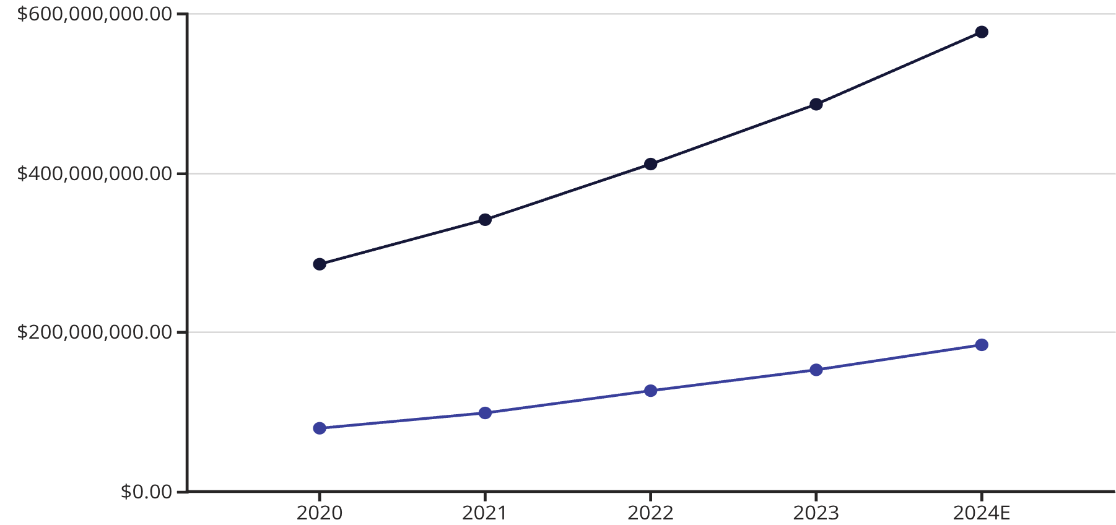
FINANCIAL PERFORMANCE
Strong Historical Financial Performance
Financial Highlights
The company has delivered exceptional growth with consistent margin expansion, demonstrating the quality and scalability of the business model.
Revenue CAGR of 19% from 2020-2024E, accelerating in recent years
EBITDA margin expansion of 450 basis points over the period
Strong cash generation with conversion rates above 85%
Minimal customer concentration with top 10 clients representing only 18% of revenue
Recurring revenue comprising 78% of total revenue, providing visibility
Revenue
EBITDA

Slide 9
Financial Projections and Returns Analysis
Our five-year financial model incorporates conservative assumptions while capturing significant value creation opportunities. The projections reflect realistic market growth, operational improvements, and strategic initiatives already underway.
Revenue Build-Up
$892M
$312M
Organic Growth: 12-15% annual growth driven by market expansion and share gains
Pricing: 3-4% annual price increases supported by strong value proposition
New Products: $50M incremental revenue by Year 3 from innovation pipeline
M&A: Two bolt-on acquisitions contributing $120M in revenue by Year 4
International: Geographic expansion driving $200M incremental revenue by Year 5
Year 5 Revenue
Year 5 EBITDA
Representing 15% CAGR from current base
35% margin reflecting operational leverage
$4.2B
28%
EBITDA Enhancement
Exit Enterprise Value
Gross IRR
Based on 13.5x exit multiple
Attractive risk-adjusted returns
Gross margin improvement of 200bps through technology optimization
SG&A leverage driving 300bps of operating margin expansion
Working capital improvements releasing $45M of cash

Slide 10
Investment Thesis: Five Pillars of Value Creation
01
02
03
Revenue Acceleration
Margin Expansion
Strategic M&A
Expand into underpenetrated markets and customer segments while accelerating product innovation cycles
Drive operational leverage through technology investments and process optimization initiatives
Execute disciplined buy-and-build strategy targeting complementary capabilities and geographic expansion
04
05
Commercial Excellence
Multiple Expansion
Upgrade sales and marketing capabilities to improve conversion rates and reduce customer acquisition costs
Position company for premium valuation through enhanced growth profile and strategic positioning

Slide 11
VALUE CREATION ROADMAP
100-Day Plan and Beyond
We have developed a detailed value creation roadmap with clear milestones, ownership, and accountability mechanisms. This plan has been validated through extensive due diligence and management discussions.
Days 1-100: Foundation
Years 2-3: Scale
Complete management assessment and align on strategic priorities
Establish enhanced reporting and KPI tracking infrastructure
Launch pricing optimization initiative across customer segments
Initiate technology architecture review and modernization planning
Begin M&A pipeline development with focus on strategic targets
Complete second strategic acquisition to achieve market leadership
Scale international operations to 35% of total revenue
Achieve target operating margins through full realization of initiatives
Build out product suite to address adjacent market opportunities
Strengthen management team with key functional hires
1
2
3
4
Months 4-12: Acceleration
Years 4-5: Positioning
Execute first bolt-on acquisition to expand capabilities or geography
Launch sales excellence program with upgraded CRM and enablement
Implement operational improvements targeting $15M EBITDA impact
Introduce first new product from innovation pipeline
Expand international presence with dedicated country management
Establish clear market leadership across core segments
Demonstrate sustainable above-market growth trajectory
Optimize capital structure and prepare for exit process
Position company for premium valuation or strategic sale
Document value creation story for exit marketing

Slide 12

Management Team Assessment
Exceptional Leadership in Place
The management team combines deep industry expertise with proven execution capabilities. The CEO has 20+ years of sector experience and successfully scaled two previous companies through significant growth phases.
Key Strengths: The team has demonstrated strong strategic thinking, operational discipline, and ability to execute against ambitious plans. They have successfully navigated multiple business cycles and competitive challenges while maintaining culture and employee engagement.
Development Opportunities: We have identified specific areas where the team would benefit from additional capabilities, including international expansion expertise and M&A integration experience. Our value creation plan includes targeted functional hires to address these gaps.
Retention and Incentives: We have designed a comprehensive management incentive plan that aligns interests with our investment thesis and ensures key personnel remain committed through the hold period and value creation initiatives.

Slide 13




Leadership Team Profiles
Chief Executive Officer
Chief Financial Officer
Chief Technology Officer
Chief Revenue Officer
Sarah Chen brings 22 years of industry leadership experience, including previous roles as COO of a Fortune 500 competitor and founding executive of a successful industry startup. MBA from Stanford; proven track record of value creation.
Michael Roberts joined from a Big 4 advisory practice where he specialized in growth company finance. Previously served as VP Finance for two PE-backed portfolio companies. CPA and CFA charterholder with strong capital markets experience.
Jennifer Martinez has consistently exceeded revenue targets throughout her 18-year career. She built and scaled sales organizations at two high-growth SaaS companies, demonstrating expertise in both enterprise and mid-market motions.
David Kumar has led product and engineering teams at leading technology companies for 15 years. He holds 12 patents and has successfully overseen three major platform migrations. Computer Science PhD from MIT with deep technical expertise.

Slide 14
RISK ANALYSIS
Risk Assessment and Mitigation Strategies
We have conducted comprehensive risk analysis across multiple dimensions and developed specific mitigation strategies for each identified risk. Our approach combines proactive risk management with contingency planning to protect value.
Market and Competition Risk
Risk: Market growth could slow due to economic downturn, or new competitive threats could emerge from well-funded technology players or adjacent market participants entering the space.
Mitigation: The company's strong market position, diversified customer base, and recurring revenue model provide resilience. We have modeled downside scenarios with market growth at 50% of base case. Competitive moats including network effects and switching costs protect against new entrants. We maintain active market monitoring and rapid response capabilities.
Execution and Integration Risk
Risk: Value creation initiatives may take longer to implement or deliver lower-than-expected returns. M&A integration could prove challenging, distracting management or destroying value.
Mitigation: Our 100-day plan is conservative and focuses on proven initiatives with clear accountability. We have allocated dedicated resources for integration management and will sequence acquisitions to avoid overwhelming the organization. Base case returns do not require M&A success. Regular monitoring and course correction processes are embedded in governance.
Key Person and Talent Risk
Risk: Loss of critical management team members or key technical personnel could disrupt operations and delay strategic initiatives.
Mitigation: We have structured retention packages for top 15 executives with time and performance vesting. Succession planning for critical roles is underway. We are building bench strength in key functional areas. Company culture and employee engagement scores are strong, reducing flight risk. We will implement stay bonuses and accelerated equity vesting for critical personnel.
Technology and Cybersecurity Risk
Risk: Technology disruption could render current platforms obsolete, or a significant cybersecurity incident could damage reputation and customer trust.
Mitigation: The company invests 14% of revenue in R&D, maintaining technology leadership. Architecture is modern and modular, enabling rapid adaptation. Comprehensive cybersecurity program includes 24/7 monitoring, regular penetration testing, and cyber insurance coverage. SOC 2 Type II and ISO 27001 certifications provide third-party validation of security controls.

Slide 15
Regulatory and Macroeconomic Risks
Regulatory Environment
Macroeconomic Sensitivity
Current Landscape: The company operates in a moderately regulated environment with compliance requirements that are well-understood and manageable. Recent regulatory changes have actually benefited the business by creating additional demand for the company's solutions.
Business Resilience: Historical performance demonstrates relative insulation from economic cycles, with the company maintaining positive growth even during the 2020 downturn. The mission-critical nature of the company's solutions and high switching costs provide demand stability.
Potential Changes: We have identified three potential regulatory scenarios that could impact the business, ranging from minimal additional requirements to more substantial compliance burdens. Even in the most restrictive scenario, the company's existing capabilities and compliance infrastructure position it well relative to competitors.
Scenario Analysis: We have stress-tested the investment across various economic scenarios including recession, sustained inflation, and credit market disruption. Even in severe downside cases, the company maintains positive cash flow and the investment generates acceptable returns.
Financial Flexibility: Conservative capital structure with significant debt capacity provides cushion to weather difficult periods. Variable cost structure enables rapid cost adjustment if needed without impacting core capabilities.
Monitoring and Response: We maintain active relationships with industry associations and regulatory bodies to ensure early visibility into potential changes. The company has dedicated regulatory affairs resources and outside counsel on retainer to provide rapid response capabilities.

Slide 16
Downside Protection and Sensitivity Analysis
We have conducted extensive sensitivity analysis to understand the range of potential outcomes and ensure adequate downside protection. Our base case incorporates conservative assumptions, while multiple value creation levers provide optionality and upside potential.
Scenario Modeling
73%
Base Case (60% probability): Execution of value creation plan as designed delivers 2.5x MOIC and 28% gross IRR over five years. This scenario assumes market growth at consensus forecast, successful implementation of operational initiatives, and completion of planned M&A.
Revenue from Existing Customers
Recurring revenue and upsell opportunities provide stability
Upside Case (20% probability): Acceleration of one or more value drivers through market outperformance, exceptional M&A execution, or breakthrough product innovation delivers 3.2x MOIC and 36% gross IRR.
118%
Net Revenue Retention
Downside Case (20% probability): Slower market growth, execution challenges, or competitive pressure results in more modest outcomes of 1.6x MOIC and 16% gross IRR. Even in this scenario, investment generates acceptable absolute and relative returns.
Demonstrates pricing power and expansion potential
85%
Cash Conversion Rate
Strong cash generation provides flexibility and resilience

Slide 17
DUE DILIGENCE
Comprehensive Due Diligence Process
We have completed a rigorous due diligence process engaging leading advisors across all critical workstreams. The process uncovered no fatal flaws and validated our investment thesis while identifying specific opportunities and risks that inform our value creation plan.
1
Financial & Tax
2
Commercial
Quality of earnings analysis confirmed sustainable EBITDA with minimal adjustments. Tax structure is efficient with no significant contingent liabilities. Working capital requirements are well-understood and forecasted conservatively.
Customer reference checks were universally positive with NPS of 72. Market sizing validated our assumptions. Competitive positioning confirmed through win/loss analysis and expert networks. Pricing has significant room for optimization.
3
Technology
4
Legal & Compliance
Platform architecture is modern and scalable with limited technical debt. Security controls are institutional-grade. IP portfolio is strong with clear freedom to operate. Technology roadmap is realistic and well-resourced.
Clean cap table with no material litigation or regulatory issues. Customer contracts are favorable with standard terms. Compliance programs are robust and meet industry standards. No significant legal risks identified.

Slide 18
Exit Strategy and Liquidity Options
Multiple Exit Paths
Strategic Exit Routes
The target company's characteristics make it attractive to multiple buyer categories, providing optionality and reducing execution risk. We have identified 12 potential strategic acquirers and 8 financial sponsors who have completed relevant transactions.
Strategic Sale: Most likely exit path given consolidating market dynamics and strategic value to larger players seeking capabilities or scale
Secondary Sale: Attractive to larger PE firms or growth equity investors given scale, growth profile, and defensible market position
IPO: Viable option if public market conditions are favorable and company exceeds $1B revenue threshold with clear path to profitability
Dividend Recapitalization: Potential interim option to return capital while maintaining ownership and continuing value creation
Exit Timing: Our base case assumes a 5-year hold period, but the business could be exit-ready in year 4 if value creation initiatives accelerate. Strong public market comps provide IPO optionality, though we view this as lower probability.
Recent comparable transactions in the sector have commanded premium valuations, with strategic buyers paying 12-15x EBITDA for high-quality assets. Our exit assumptions of 13.5x EBITDA are conservative relative to recent precedents.

Slide 19
Investment Summary and Recommendation
This investment opportunity represents an exceptional combination of attractive market dynamics, defensible competitive positioning, strong financial performance, and proven management capabilities. The target company operates in a large and growing market where it holds clear leadership position supported by multiple structural advantages.
Our comprehensive due diligence process has validated the investment thesis and identified specific value creation opportunities that underpin our return expectations. We have developed a detailed roadmap with clear milestones, accountability, and risk mitigation strategies to ensure successful execution.
1
Strong Strategic Fit
2
Attractive Risk-Return Profile
3
Executable Value Creation Plan
Aligns perfectly with our investment strategy targeting market leaders in growing sectors with defensive characteristics and multiple value creation levers
Conservative base case delivers 2.5x MOIC and 28% IRR with significant upside optionality and adequate downside protection through business resilience
Clear roadmap with realistic initiatives, adequate resources, and management team capable of delivering against ambitious but achievable targets
Recommendation: We recommend proceeding with this investment at the proposed terms. The opportunity meets all our investment criteria and represents one of the most compelling opportunities we have evaluated this year.

Slide 20
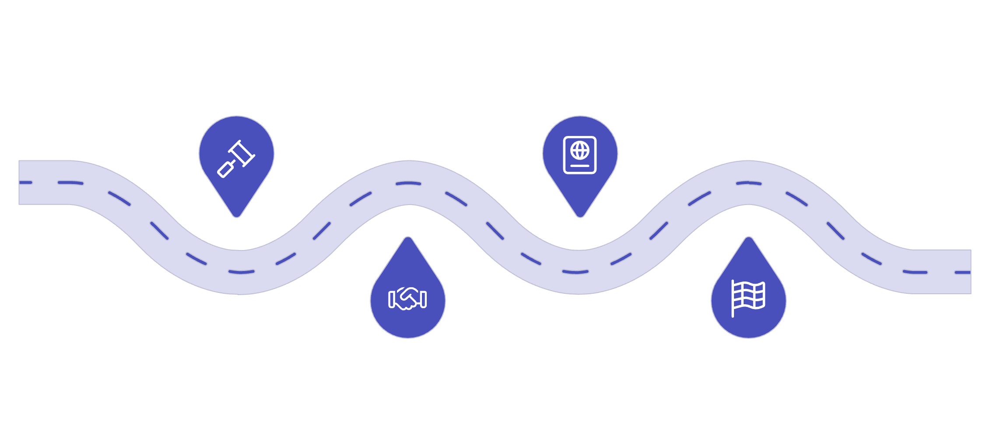
Next Steps and Decision Timeline
IC Approval
Definitive Agreement
Seek committee sign-off within two weeks
Draft and execute definitive documents
Final Negotiations
Transaction Close
Resolve key commercial and legal terms
Complete signing and funds transfer
We are requesting Investment Committee approval to proceed with final negotiations and move toward definitive documentation. The competitive process timeline requires decision within two weeks to maintain our position.
01
02
Investment Committee Decision
Final Negotiations and LOI
Seeking approval to proceed to final negotiations and execute Letter of Intent within 5 business days
Finalize purchase price, structure, and terms with target and execute binding LOI providing 60-day exclusivity
03
04
Confirmatory Due Diligence
Documentation and Closing
Complete final workstreams including IT deep-dive, management assessments, and facility visits over 45-day period
Negotiate and execute definitive purchase agreement, complete financing, and close transaction within 90 days of IC approval
Contact: For questions or additional information, please contact the deal team. We are prepared to present to the Investment Committee at your earliest convenience.

